Slide 1
NanoProcessor Design and Implementation
Group 01

Slide 2
Project Overview
Objective:
Design a 4-bit processor supporting arithmetic, logical, and control-flow operations.
Extend functionality with bitwise operations (AND/OR/XOR), multiplication, and comparison.
Key Features:
12-bit instruction set with MOVI, ADD, SUB, NEG, JZR, AND, OR, XOR, MUL, and CMP operations
Backward compatibility with original instruction set.
FPGA implementation on Basys 3 board with 7-segment display output

Slide 3
Instruction Set Architecture
Original Instructions Set:
Instruction | Description | Instruction
MOVI R, d | Load immediate d into R | 10 RRR 000 dddd
ADD Ra, Rb | Ra = Ra + Rb | 00 RaRaRa RbRbRb 0000
NEG R | R = -R | 01 RRR 0000000
JZR R, d | Jump to d if R == 0 | 11 RRR 0000 ddd

Slide 4
Instruction Set Architecture
Instruction Set Architecture
Extended Instructions Set:
Instruction | Description | Instruction
SUB Ra, Rb | Ra = Ra - Rb | 00 RaRaRa RbRbRb 0001
AND Ra, Rb | Ra = Ra & Rb | 00 RaRaRa RbRbRb 0010
OR Ra, Rb | Ra = Ra | Rb | 00 RaRaRa RbRbRb 0011
XOR Ra, Rb | Ra = Ra ^ Rb | 00 RaRaRa RbRbRb 0100
MUL Ra, Rb | Ra = Ra * Rb | 00 RaRaRa RbRbRb 0101
CMP Ra, Rb | Compare Ra and Rb | 00 RaRaRa RbRbRb 0111

Slide 5
Instruction Encoding
2-bit Opcodes:
Instruction Type | OP Code
ALU Operations | 00
NEG | 01
MOVI | 10
JZR | 11

Slide 6
Instruction Encoding
4-bit Sub opcodes:
ALU Operation | Operation Selection | Subop Code
ADD | 000 | 0000
SUB | 001 | 0001
NEG | 010 | -
AND | 011 | 0010
OR | 100 | 0011
XOR | 101 | 0100
MUL | 110 | 0101
CMP | 111 | 0111

Slide 7
Assembly Program and Machine Code
Original Version:
"101110000011", -- MOVI R7,3 ; Load value 3 into R7 (loop counter) "100010000001", -- MOVI R1,1 ; Load immediate value 1 into R1 "010010000000", -- NEG R1 ; Negate R1 to get -1 "100100000011", -- MOVI R2,3 ; Load immediate value 3 into R2 (initial value) "001110010000", -- ADD R7,R1 ; Subtract 1 from R2 (Adding negated value) "001110100000", -- ADD R7,R2 ; Add R2 to accumulator in R7 "110100000110", -- JZR R2,6 ; Jump to address 6 if R2 is zero "110000000100" -- JZR R0,4 ; Jump to address 4 if R0 is zero (always true)

Slide 8
Assembly Program and Machine Code
Extended Version:
"101110000101", -- 0: MOVI R7,5 ; R7 ← 5 (0101)
"101100000011", -- 1: MOVI R6,3 ; R6 ← 3 (0011)
"001111100000", -- 2: ADD R7,R6 ; R7 ← R7 + R6 = 8 (1000)
"001101110001", -- 3: SUB R6,R7 ; R6 ← R6 - R7 = -5 (1011)
"001111100101", -- 4: MUL R7,R6 ; R7 ← R7 * R6 = 8 (with overflow)
"001101110011", -- 5: OR R6,R7 ; R6 ← R6 OR R7 = 11 OR 8 = 11 (1011)
"001111100100", -- 6: XOR R7,R6 ; R7 ← R7 XOR R6 = 8 XOR 11 = 3 (0011)
"001111000111" -- 7: CMP R7,R6 ; Compare R7(3) with R6(11): GT=1

Slide 9
System Overview
Core Components:
Program ROM
Program Counter + 3-bit Adder
Instruction Decoder
Register Bank
Adder/Subtractor Unit
High Level Diagram
Additional Components:
Comparator
Multiplier
Bitwise Operator

Slide 10
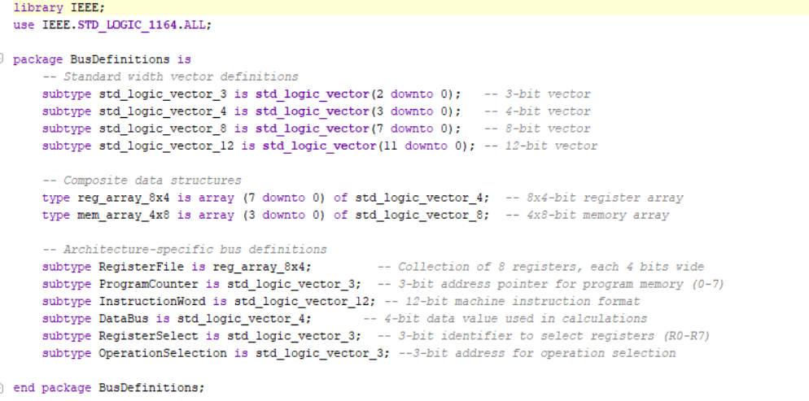
Data Movement
Bus system was used to simplify data movement:

Slide 11
Top Module (Original)
Core Control:
Clock: Synchronizes all operations (fetch, decode, execute).
Reset: Initializes registers and program counter to zero.
Data Visibility:
Data: Outputs the value of Register 7 (R7) for real-time monitoring.
S_7Seg & Anodes: Drives the 7-segment display to show R7’s value in hexadecimal.

Slide 12
Top Module (Original)
Status Flags:
Overflow: Indicates arithmetic overflow
Zero : ALU result is zero
Integration Hub:
Coordinates the Program Counter, Instruction Decoder, ALU, and Register Bank.
Maps internal register states to external displays for validation.

Slide 13
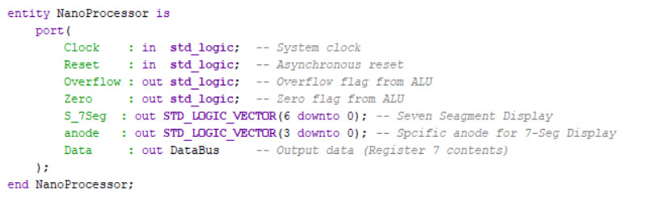
Top Module (Original)

Slide 14
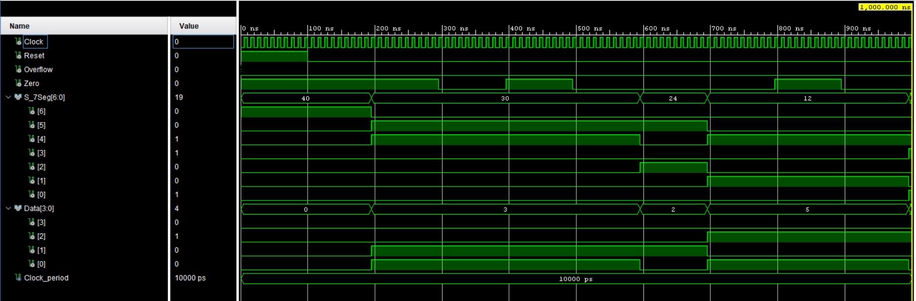
Top Module (Original)
Timing Diagram

Slide 15
Top Module (Extended)
Multi-Register Monitoring:
Data_7: Outputs Register 7 (R7) for primary result display
Data_6: Added output for Register 6 (R6), enabling side-by-side operation observation
Advanced Status Flags:
Comparison Flags: Equal, LessThan, GreaterThan for conditional logic
Backward Compatibility: Retains original Zero and Overflow flags

Slide 16
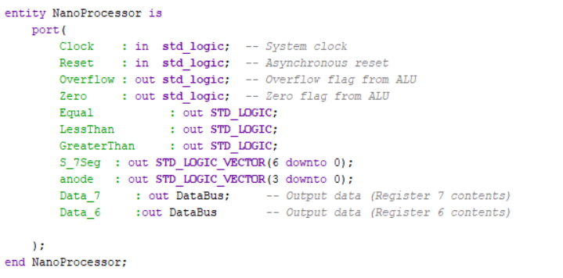
Top Module (Extended)

Slide 17
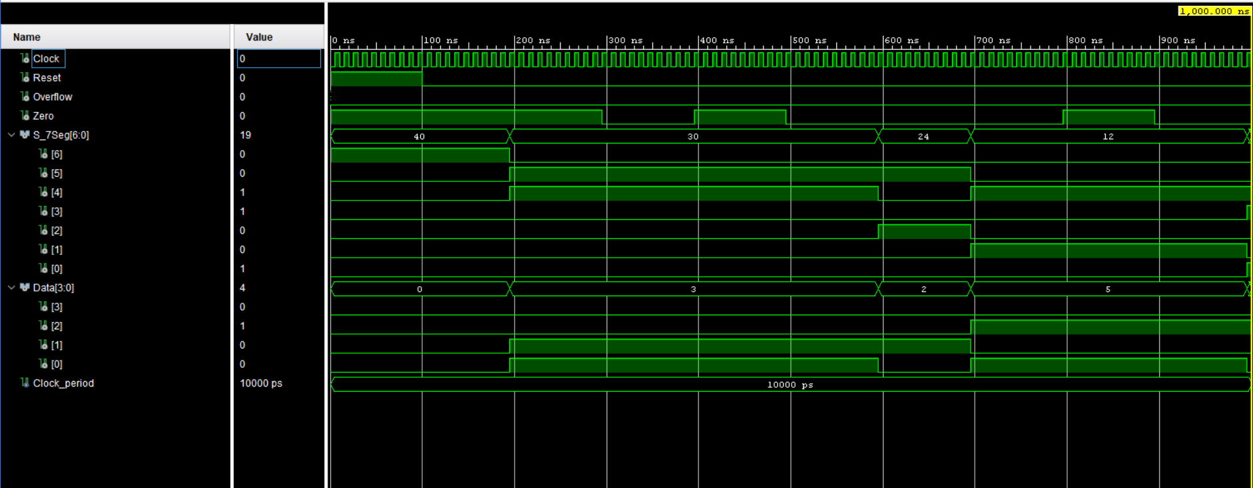
Top Module (Extended)
Timing Diagram

Slide 18
Core Components

Slide 19
ROM
Key Features:
8x12-bit Memory: Stores up to 8 instructions (12-bit each) for nano-scale programs.
PC-Driven Addressing: Program Counter (PC) selects instructions via 3-bit addresses (000 to 111).
Role in Pipeline:
Fetch Stage: PC value → ROM address → Outputs 12-bit instruction.

Slide 20
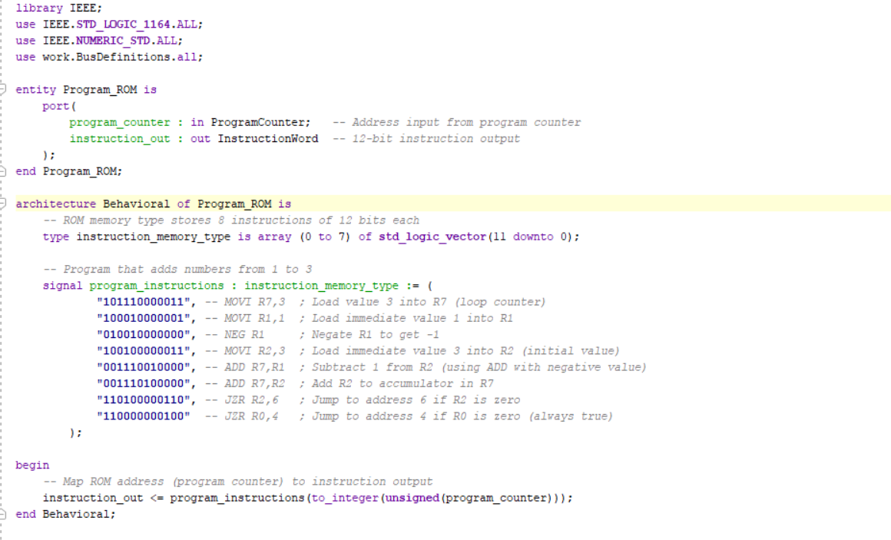
ROM

Slide 21
Program Counter & Address Control Logic
3-bit Program Counter (PC):
Function: Tracks current instruction address (0-7).
Update: On slow clock edge, loads PC_Next (from Mux).
Reset: Initializes to 000 on system reset.
3-bit Adder (PC_Adder):
Role: Calculates sequential address (PC_Current + 1).
Example: 010 → 011 (next instruction).

Slide 22
Program Counter & Address Control Logic
2-Way 3-bit Mux (Address_Selector):
Inputs:
Sequential_Address (PC + 1)
Jump_Address (from instruction decoder)
Control :
Jump_Enable signal selects jump vs. sequential flow.

Slide 23
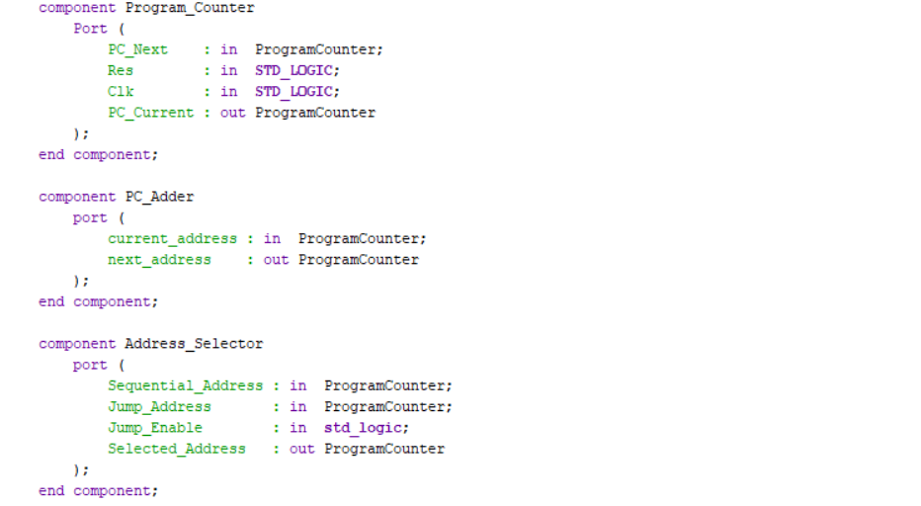
Program Counter & Address Control Logic

Slide 24
Slow Clock
How the Slow Clock works:
Convert high-frequency system clock into a much slower clock signal. ( from 50MHz to 0.5 Hz )
Enable manual debugging and LED visualization
On every rising edge of the input clock, we do count = count +1
Slow Clock directly give inputs to the program counter and register bank.
Connects to instruction decoder and ALU.

Slide 25
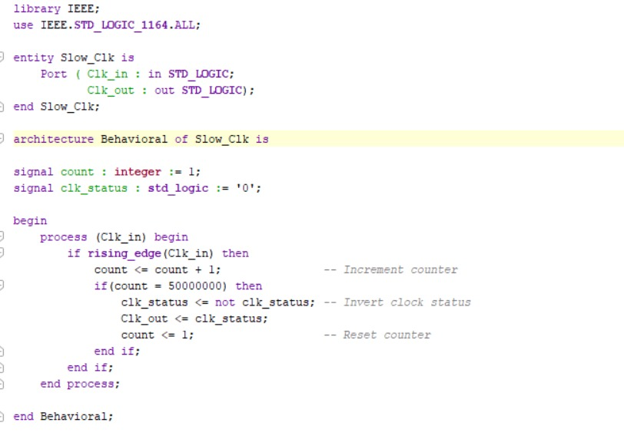
Slow Clock

Slide 26
Instruction Decoder (Original)
Opcode Extraction:
Bits 11-10: Define operation type (MOVI, ADD, NEG, JZR).
Signal Generation:
Register Control: Reg_Enable, Reg_Select_A/B for operand selection.
ALU Control: Operation_Select (ADD/SUB).
Immediate Handling: Extracts 4-bit constant for MOVI.
Jump Logic: Activates Jump_Enable if register value is zero.

Slide 27
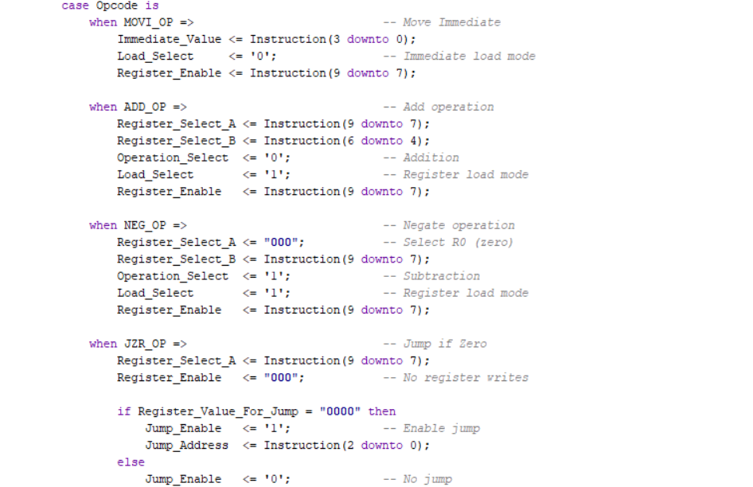
Instruction Decoder - (Original)

Slide 28
Instruction Decoder (Extended)
Opcode Extraction:
Bits 11-10: Define operation type (MOVI, ADD, NEG, JZR).
Sub-Opcode Extraction:
Bits 3-0: Specifies ALU operation for ALU_OP (ADD/SUB/AND/OR/XOR/MUL/CMP).

Slide 29
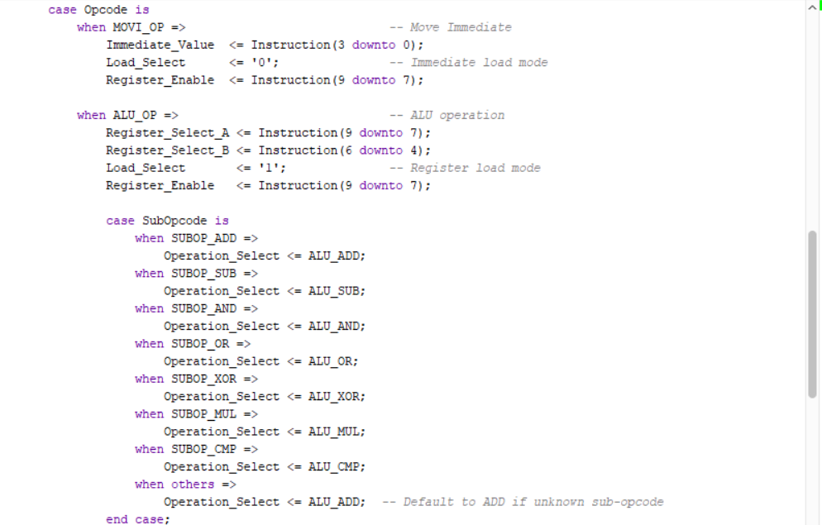
Instruction Decoder (Extended)

Slide 30
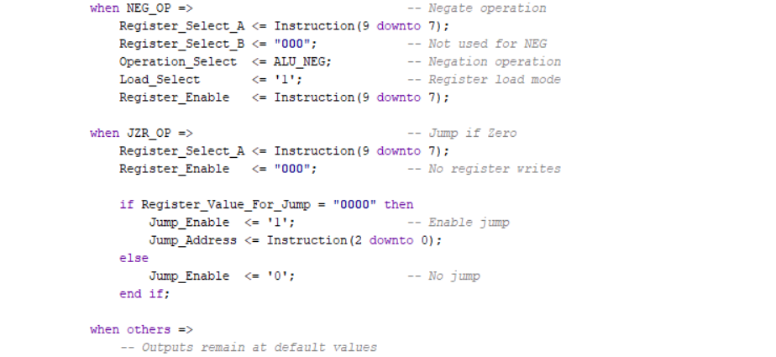
Instruction Decoder (Extended)

Slide 31
Load Selector
Purpose:
Chooses between immediate values (for MOVI instructions) and ALU results.
Control Logic:
Uses a 2-way 4-bit multiplexer (Mux_2way_4bit) governed by the Load_Select signal from the instruction decoder.

Slide 32
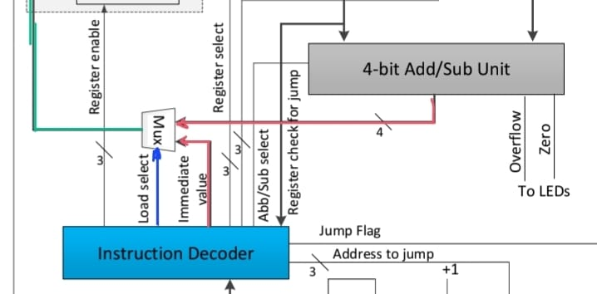
Load Selector

Slide 33
Register Bank
Key Components:
3-to-8 Decoder:
Converts 3-bit Reg_En to one-hot enable signals (e.g., "101" → Enable R5).
Register Cells (R1-R7):
Write Logic: Updates only when Reg_Sel[X] = 1 and clock rises.
Reset: Asynchronously clears all registers to 0000 (except R0).

Slide 34
Register Bank
Operation Flow:
Write Phase:
Decoder activates target register via Reg_En (e.g., "111" for R7).
Data bus value stored on clock edge.
Read Phase:
All registers output values continuously (combinational read).
Design Features:
Simultaneous Access: All register values available via Register_Outputs.
Safety Mechanism: R0 prevents accidental overwrites of zero constant.

Slide 35
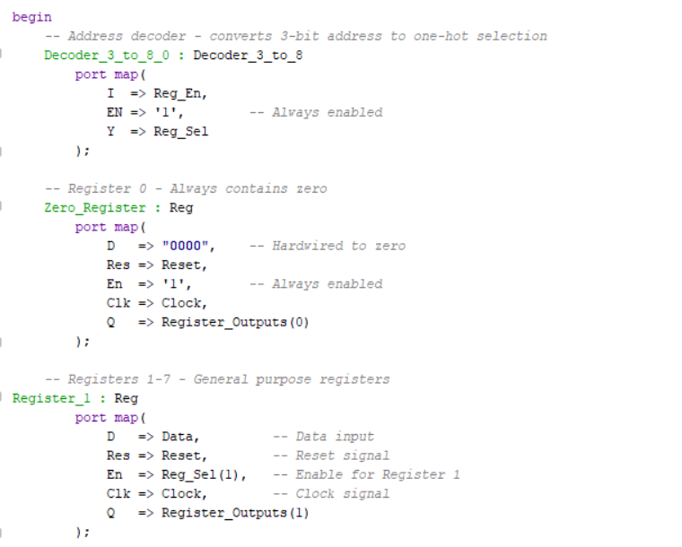
Register Bank
VHDL Implementation:

Slide 36
Register Data Multiplexer
Function :
The Register Data Multiplexer is an 8-to-1, 4-bit multiplexer that selects and outputs data from one of eight registers (R0–R7) using a 3-bit selection address.
Control Logic
It enables access to any register for processing operations. Designed using the RegisterFile type, it receives all register outputs simultaneously and chooses one based on the SelectAddress.

Slide 37
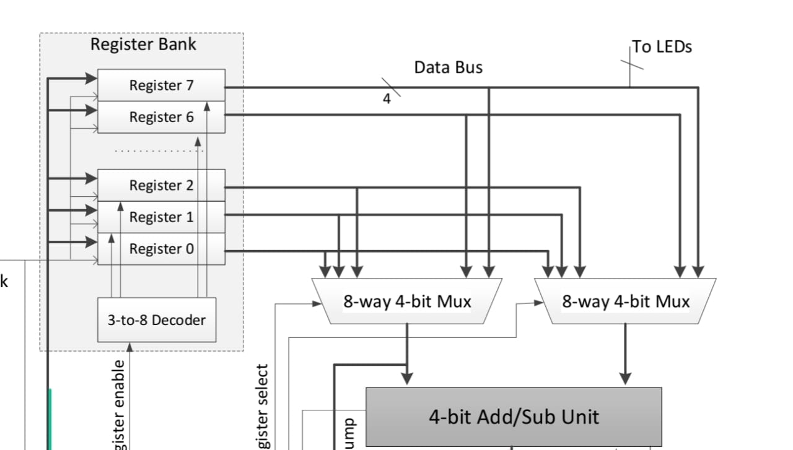
Register Data Multiplexer

Slide 38
Seven Segment Display
Operation:
Converts 4-bit register values (0-15) to 7-segment patterns for FPGA output.
Implementation:
The lookup table implements a ROM-based approach with a 16-entry array, where each entry contains a 7-bit pattern corresponding to the seven segments of the display1.
The table covers all possible 4-bit input combinations (0 through 15), mapping them to their hexadecimal display representations.

Slide 39
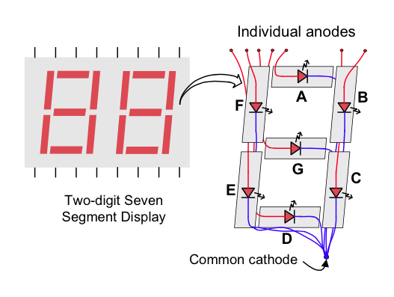
Seven Segment Display

Slide 40
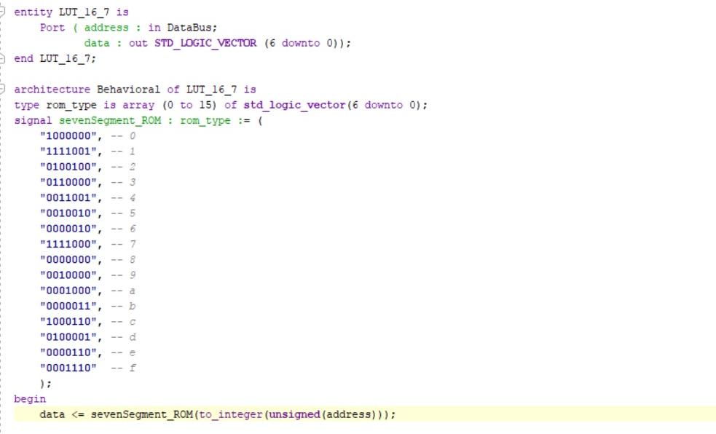
Seven Segment Display

Slide 41
Arithmetic and Logic Unit

Slide 42
Add_Sub Unit
Dual-Mode Operation:
Mode_Sel = 0: Addition (A + B)
Mode_Sel = 1: Subtraction (A - B via 2’s complement)
Key Components:
Ripple Carry Adder (RCA_4):
Performs 4-bit addition with carry propagation.
2’s Complement Logic:
XOR gates invert B during subtraction (Modified_B = B XOR Mode_Sel).
Mode_Sel doubles as carry-in (enables +1 for subtraction).

Slide 43
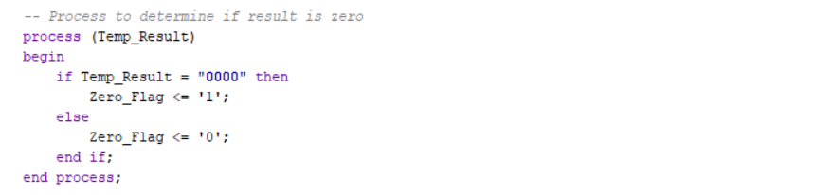
Add_Sub Unit
Zero Detection:

Slide 44
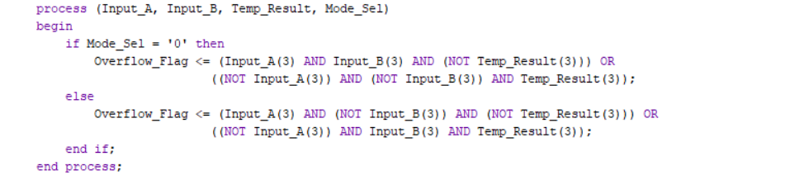
Add_Sub Unit
Overflow Detection:
Addition: Overflow if A and B have same sign ≠ result sign.
Subtraction: Overflow if A and B have different signs ≠ result sign.

Slide 45
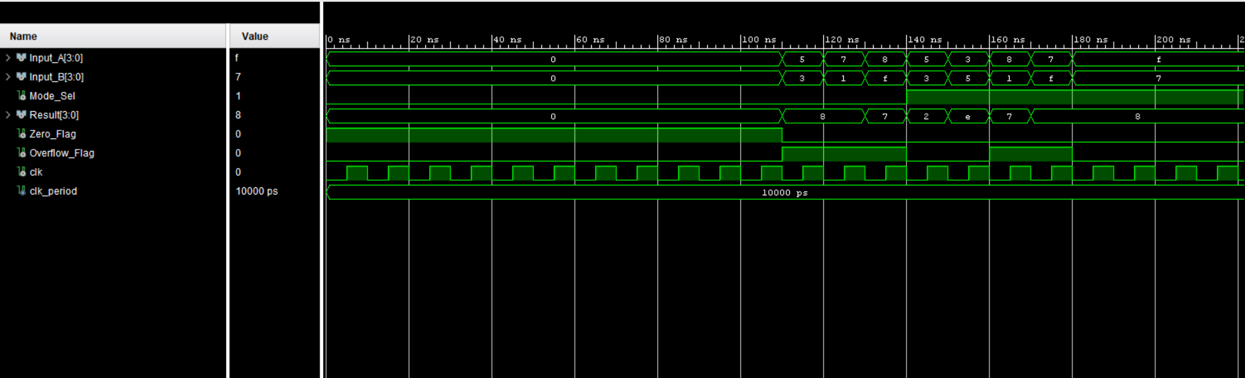
Add_Sub Unit

Slide 46
Multiplier Unit
8-bit Result Calculation:
Multiplies two 4-bit signed numbers (Input_A, Input_B) into an 8-bit result (Full_Result).
Example: -3 (1101) * 2 (0010) = -6 (11111010) → Lower 4 bits: 1010 (-6 in 4-bit).
Overflow Detection:
Compares upper 4 bits of Full_Result with sign-extension of lower 4 bits
Sign Extension: Replicates the sign bit (bit 3) of the 4-bit result.

Slide 47
Multiplier Unit
How this work?
Inputs: 4-bit signed Input_A, Input_B (2's complement) Example: A = "1100" (−4), B = "0011" (+3)
Multiply: Convert to signed, multiply → full 8-bit result −4 × 3 = −12 → "11110100"
Result Output: Output lower 4 bits → "0100" (4)
Overflow Check: Compare upper 4 bits with sign of lower result "1111" ≠ "0000" → Overflow = '1'

Slide 48
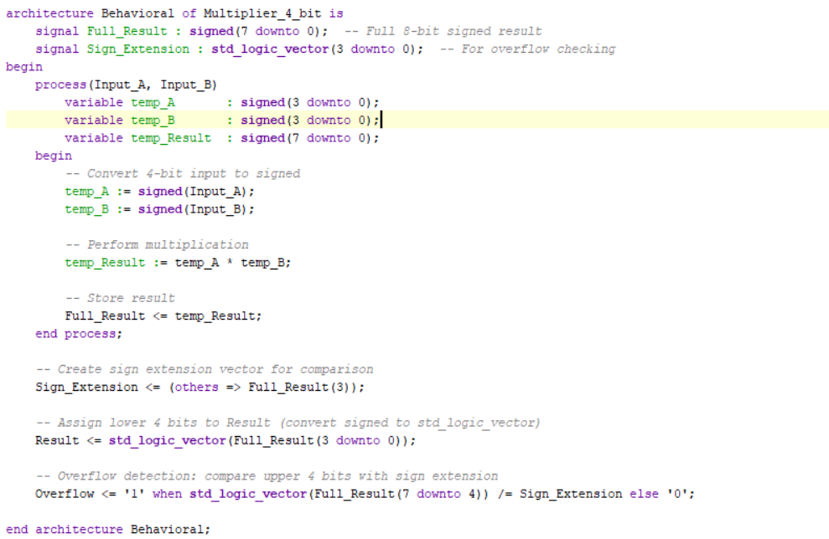
Multiplier Unit

Slide 49
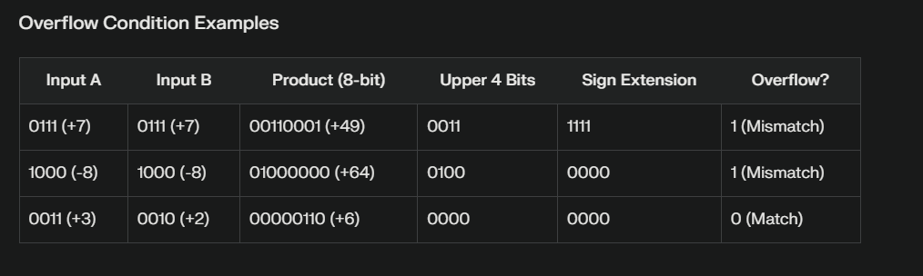
Multiplier Unit

Slide 50
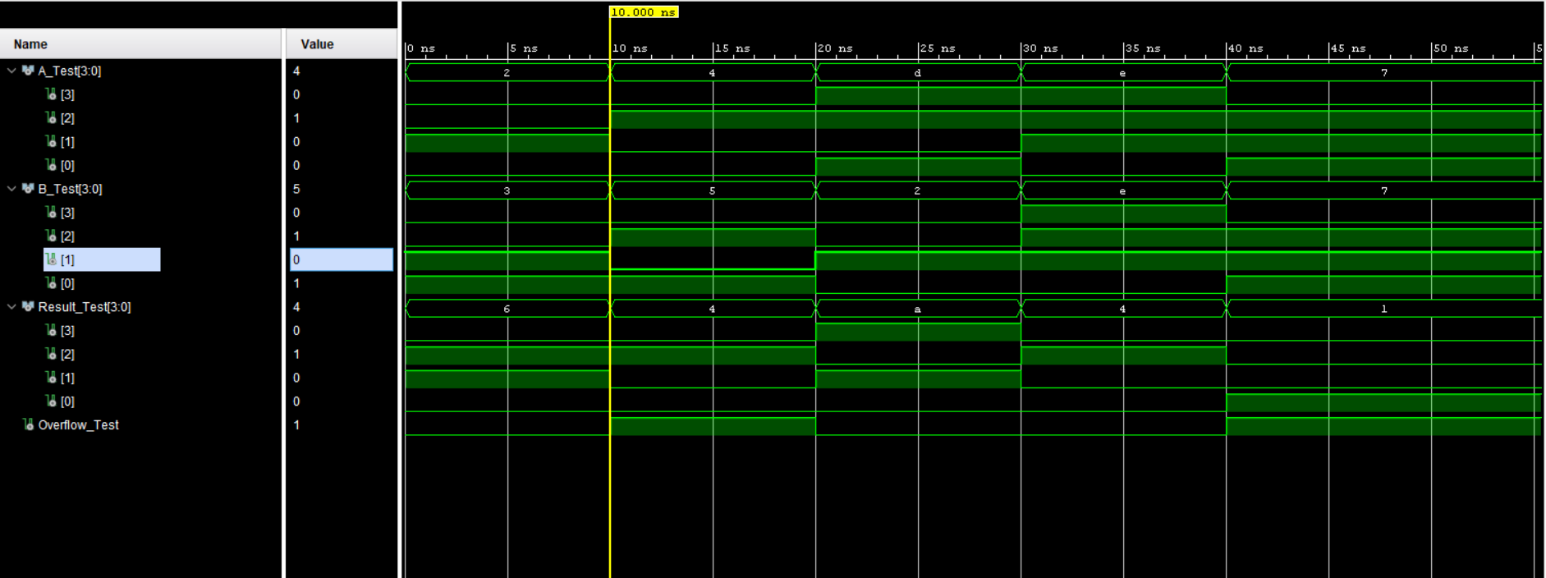
Multiplier Unit

Slide 51
Comparator Unit
Purpose :
Compare two 4-bit signed numbers using 2’s complement representation
Generates three comparison flags :
Equal_Flag
GreaterThan_Flag
LessThan_Flag
How it works :
If Input_A = Input_B , Equal_Flag = ‘ 1 ’
If Input_A < Input_B , LessTHan_Flag = ‘ 1 ’
If Input_A > Input_B , GreaterThan_Flag = ‘ 1 ‘

Slide 52
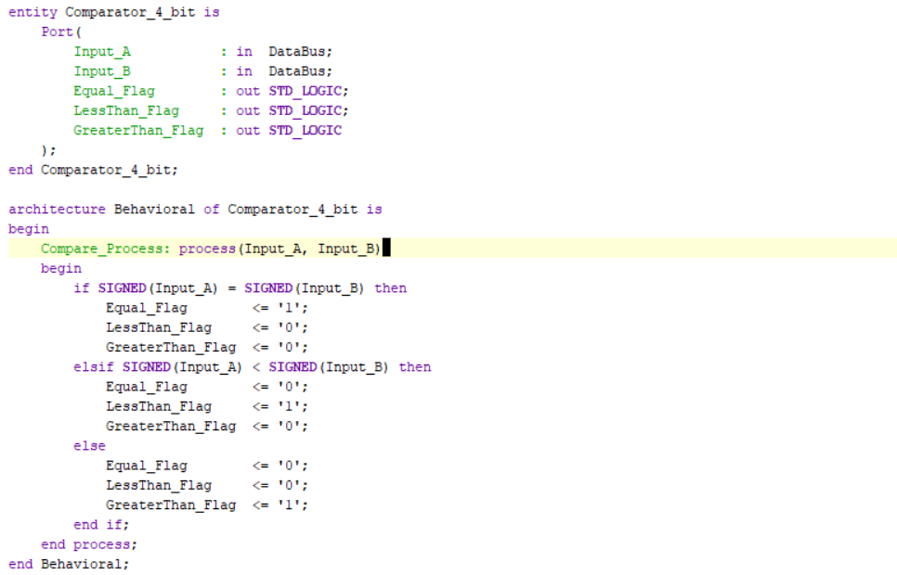
Comparator Unit

Slide 53
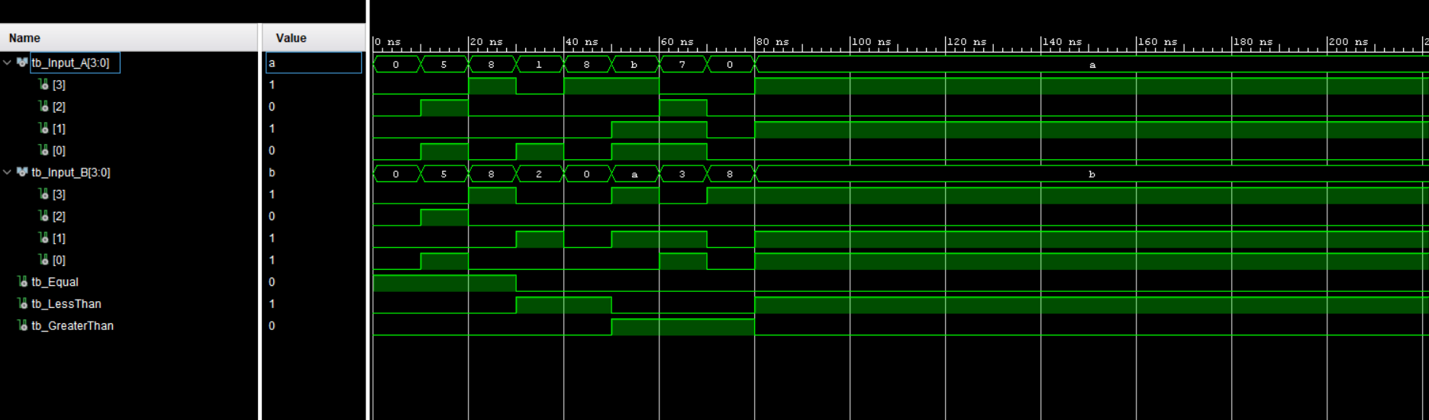
Comparator Unit

Slide 54
Bitwise Operator Unit
Core Functionality: Performs bit-level logic operations between two 4-bit values:
AND: Result = A & B (Bitwise AND)
OR: Result = A | B (Bitwise OR)
XOR: Result = A ^ B (Bitwise XOR)

Slide 55
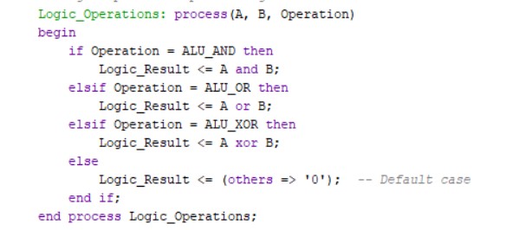
Bitwise Operator Unit

Slide 56
ALU (Extended)
Key Components:
Adder/Subtractor Unit:
Handles ADD, SUB, and NEG (via 0 - A).
Mode Control: AddSub_Mode selects add (0) or subtract (1).
Comparator Unit:
Generates Equal, LessThan, GreaterThan flags for CMP.
Multiplier Unit:
Performs 4-bit signed multiplication with overflow detection.
Bitwise Logic Unit:
Executes AND, OR, XOR operations.

Slide 57
ALU (Extended)
Flag Management:
Zero Flag:
Arithmetic/Logic: Checks if result = 0000.
Multiplier: Dedicated zero detection.
Overflow Flag:
Arithmetic: Signed overflow from adder/subtractor.
Multiplier: Overflow from truncated 8-bit result.
Comparison Flags: Direct output from comparator unit.

Slide 58
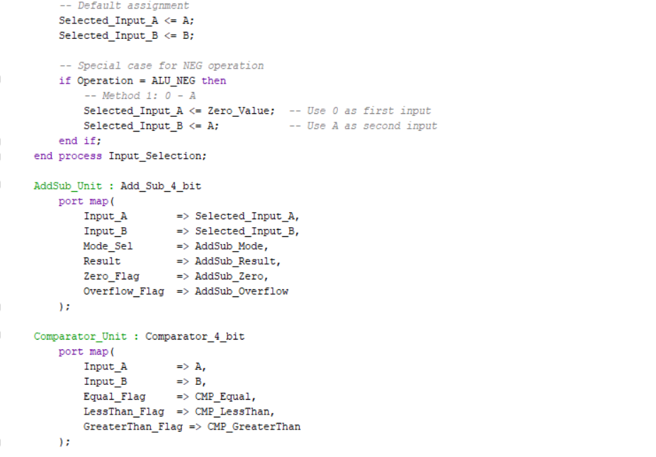
ALU (Extended)

Slide 59
ALU (Extended)

Slide 60
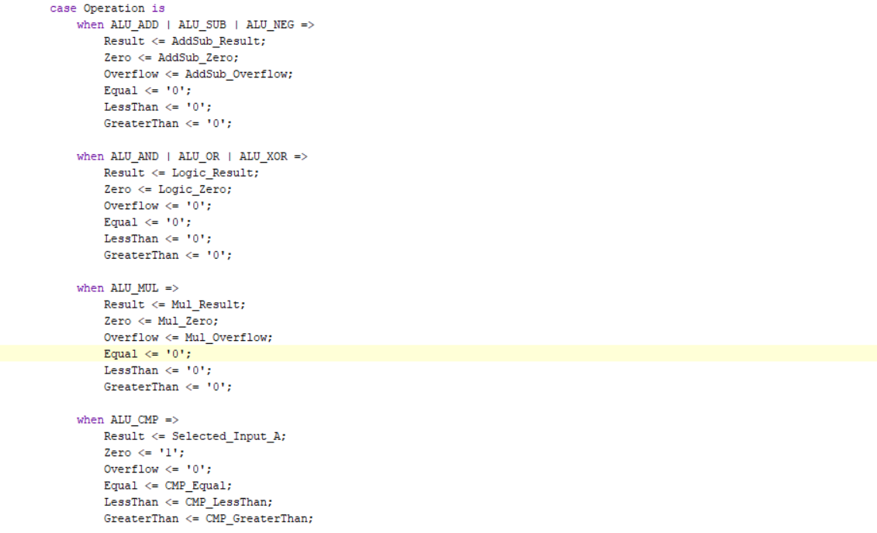
ALU (Extended)

Slide 61
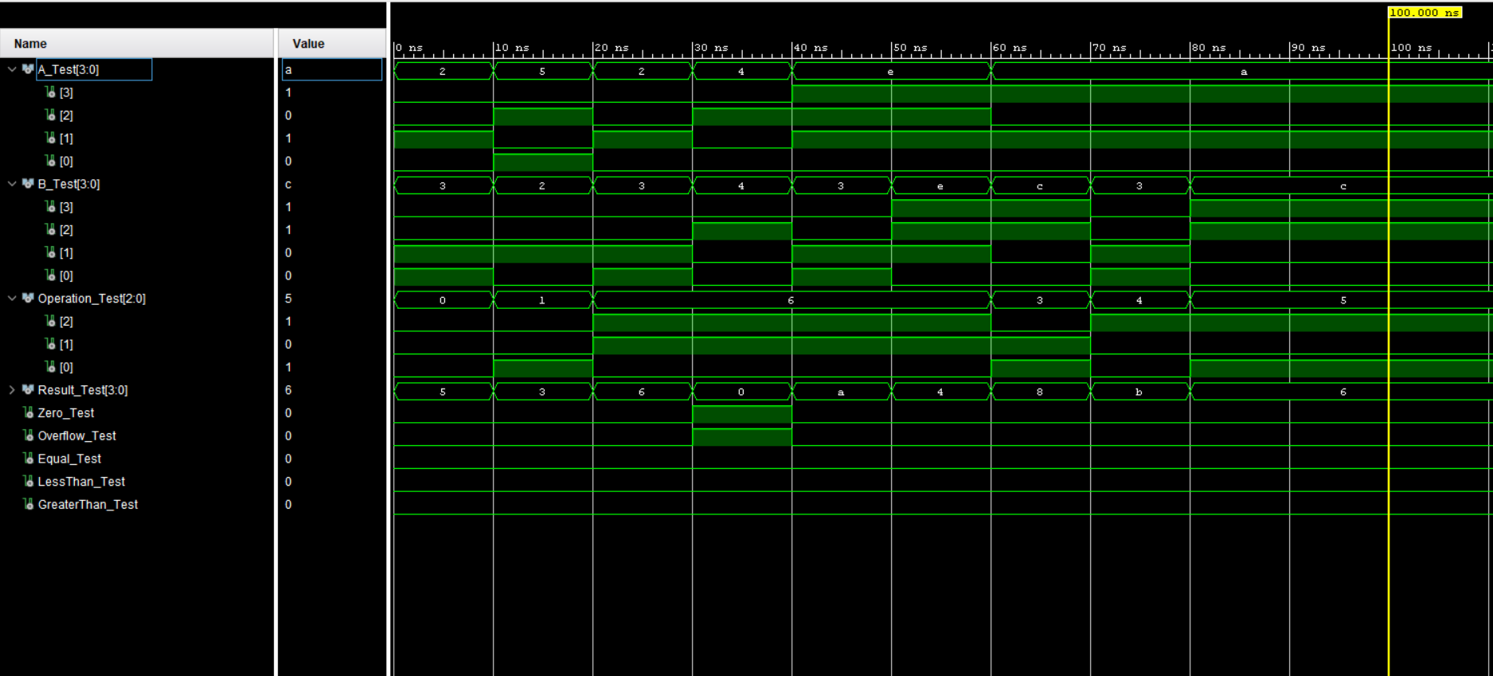
ALU (Extended)

Slide 62
Fundamental Building Blocks
1. Multiplexers (Data Selectors)
8-way 4-bit: Selects one of eight 4-bit input buses.
2-way 3-bit: Chooses between two 3-bit data paths.
2-way 4-bit: Routes two 4-bit inputs to a single output.
2. Adders
Half Adder: Adds 2 bits, outputs Sum and Carry.
Full Adder: Adds 2 inputs + Carry-in, outputs Sum and Carry-out.
3-bit Ripple Carry Adder: Cascades 3 Full Adders for 3-bit arithmetic.
4-bit Ripple Carry Adder: Performs 4-bit addition/subtraction.

Slide 63
Fundamental Building Blocks
3. Decoders
2-to-4 Decoder: Converts 2-bit input to 4 one-hot outputs (1-of-4).
3-to-8 Decoder: Maps 3-bit input to 8 enable signals (1-of-8).
4. 4-bit Register:
Stores 4-bit data
Write/read synchronized with clock

Slide 64
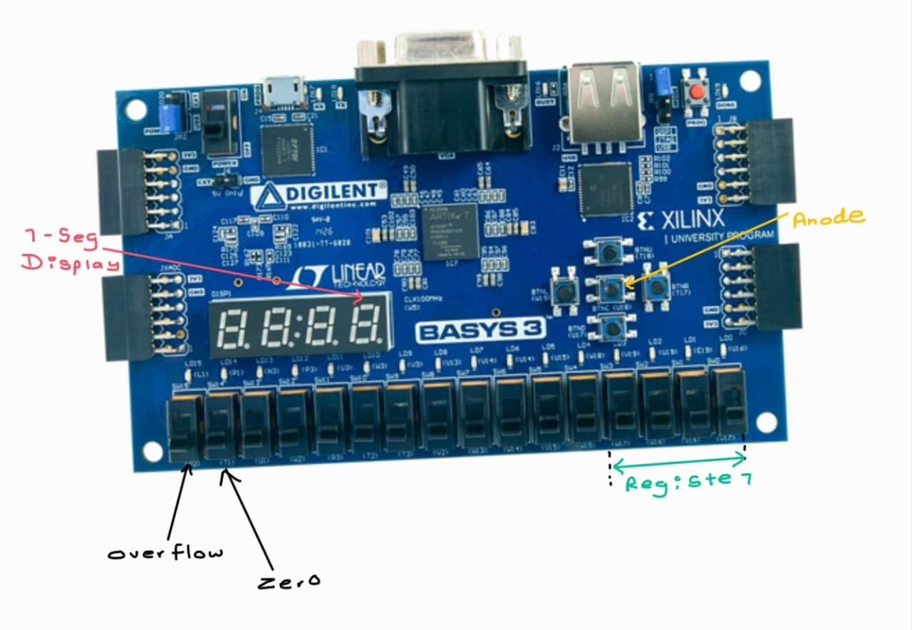
FPGA Pin Mappings (Original)

Slide 65
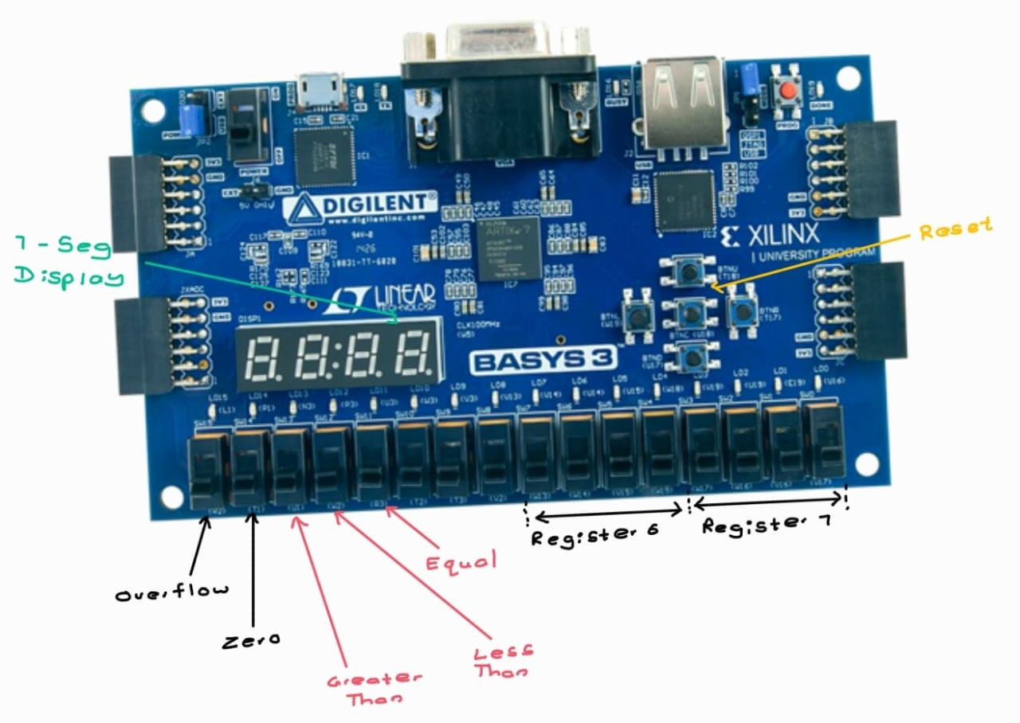
FPGA Pin Mappings (Extended)

Slide 66
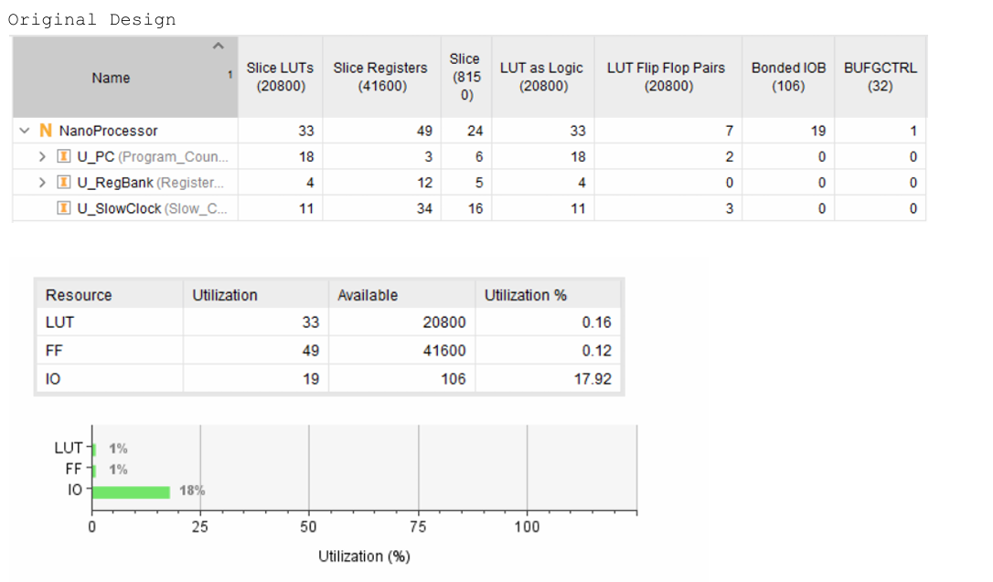
Resource Utilization (Original)

Slide 67
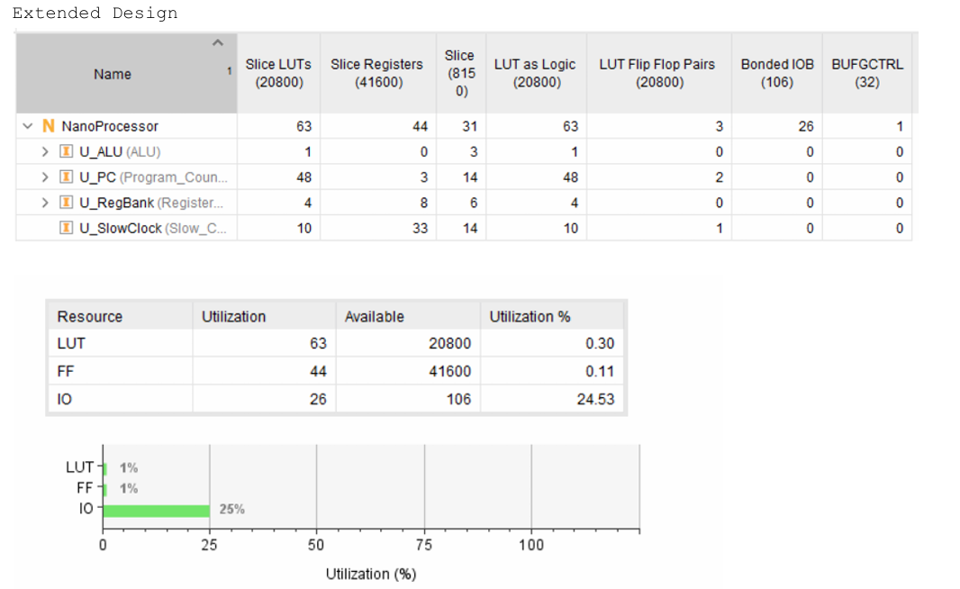
Resource Utilization (Extended)

Slide 68
Conclusion
Achievements:
4-bit Processor: Executes 8+ instructions (arithmetic, logic, control flow).
Extended Functionality: Added AND/OR/XOR, multiplication, comparisons.
FPGA Validation: Tested on BASYS3 with real-time 7-segment display output.
Key Learnings:
Modular Design: Isolated components (ALU, ROM, Decoder) for scalability.
Signed Arithmetic: Mastered two’s complement & overflow detection.
Team Collaboration: Streamlined VHDL development & testing.

Slide 69
Thank You !

